Slide 1
Data and Algorithms 6
Please turn your phone to silent mode.
Chulalongkorn University
School of Integrated Innovation
Fall 2023
Marko Niinimaki Marko.N@chula.ac.th

Slide 2
Where are we in the course
6 | 12 Sep | SQL data manipulation.
7 | 19 Sep | Building a database, the Python database interface, summary.
Midterm week: 25-29 Sep. Exam probably Tuesday morning.

Slide 3
Today’s main topics
Where is data? In programs/files/databases/...
SQL operations with the company database + a big database (100's of thousands rows).
Subtopics:
Queries from multiple tables, subqueries, “not in”, “group by”.
Inserting and deleting data (briefly).

Slide 4
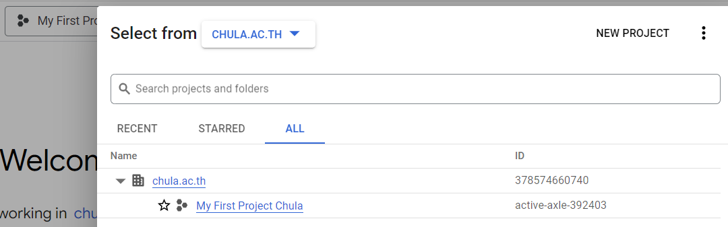
Covered last week
Google Cloud’s SQL.
Queries with the company database: select something from (just one or many tables) where (conditions).
A new shared project: You are an editor of this project .. That we’ll use for queries with a bigger database, but don’t change it yet.

Slide 5
Covered last week
Connecting to your database:
gcloud sql connect instancename --user=root
mysql>
show databases;
use company;
show tables;
describe employees;

Slide 6
How do we ..
Who is the youngest person in the company?
select max(bdate) from employee;
1972-07-31
select fname,lname from employee where bdate="1972-07-31";
OR:
select fname,lname,bdate from employee where bdate=(select max(bdate) from employee);
OR (ok, this does not use “max”)
select fname,lname,bdate from employee order by bdate desc limit 1;

Slide 7
How do we ..
List employees who are not working on project ProductY: list employees but exclude those who are working on ProductY.
First, let’s get the SSN’s of people who work on ProductY:
select ssn from employee, project, works_on where ssn=essn and pnumber=pno and
pname="ProductY";
Then, list employees but omit those people:
select fname, lname from employee where ssn not in (select ssn from employee, project, works_on where ssn=essn and pnumber=pno and pname="ProductY");

Slide 8
How do we..
Salaries by department
select dno, avg(salary) from employee group by dno;

Slide 9
The world trade database: use trade
What is it like?
country: Country_Name, ISO3digit, Cont.
Where Cont is one of: South America, Asia, Africa, North America, Europe, Oceania, Antarctica, Australia.
product: Commodity_Code, Commodity_description
The codes are so-called SITC codes 0..9710.
trade: YEAR, ORIGIN, SITC, EXPORT_VAL, IMPORT_VAL.
ORIGIN refers to country.ISO3digit, SITC refers to product.Commodity_Code

Slide 10
The world trade database
Let’s find out
1 How many rows do the tables have? select count(*) from trade;
Trade: 791961
2 How many different years of trade?
select distinct YEAR from trade; 2010-2014
3 How many countries are in Africa (this is not accurate, there is no trade data from all African countries)?
4 What was the sum of exports of Thailand (THA) in 2014?

Slide 11
The world trade database
Let’s find out
5 In 2014, what was Thailand’s most valuable export product?
6 In 2014, what were Thailand’s 3 most valuable export products?
select SITC, EXPORT_VAL from trade where YEAR=2014 and ORIGIN="THA" order by EXPORT_VAL desc limit 3;
(Then: select Commodity_Description from product where Commodity_Code=7821; etc)
7 In 2014, what was the sum of exports of all the countries in Oceania?
8 Which country (yes, we know) exported most in 2014? You can use order by.
9 Which country imported most in 2014?
select IMPORT_VAL, ORIGIN from trade where YEAR=2014 order by IMPORT_VAL desc limit 1;
10 Which country exported most processed rice in 2014 (“Rice semi-milled or wholly milled”)?
First: select * from product where Commodity_Description like "%rice%"; -> 422

Slide 12
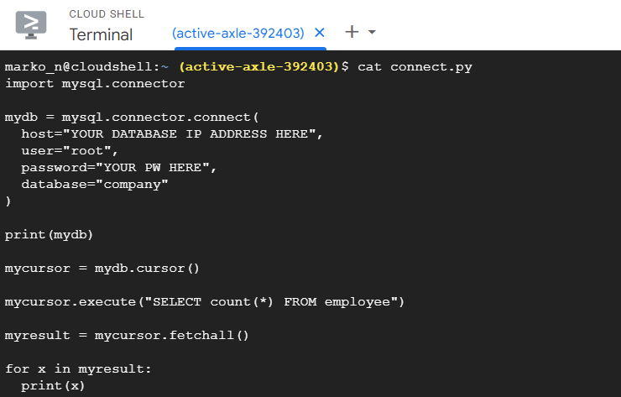
Connecting to your database using Python
Please write this kind of program inside the “Cloud Shell” at Google Cloud.
You can use this command to start an editor program: nano mydb.py
More details during the class!

Slide 13
If you want practice
https://www.khanacademy.org/computing/computer-programming/sql
(no database installation needed).

